Slide 1


BAN6440: Applied Machine Learning
Milestone Assignment One
Title: Spam Filtering Email System using Machine Learning Algorithms
Name: Mubanga Nsofu
Learner ID: 149050
Date: 24th November 2024
Lecturer: Professor Bucciarelli

Slide 2
Spam Filtering email system using machine learning algorithms - Overview
Overview
Identify and filter spam emails using Machine Learning
Standard metrics to benchmark the performance of the different algorithms
Draw conclusions based on the results
CRISP-DM was applied to ensure no steps were missed in Applied ML
Objective
Methodology
Results
Conclusions
The key objective was to implement three email spam filters based on Linear & Logistic regressors along with a Perceptron
CRISP-DM is an essential framework for applied machine learning, ensuring the business problem is understood first before any solution is applied (Roy, 2018). The dataset was obtained from Kaggle (Jackksoncsie, 2023), with text cleaning and bag of words employed for feature extraction.
Post modelling, using scikit-learn, the three models were evaluated using metrics such as Accuracy, F1- Score, and ROC-AUC. The logistic regression classifier performed the best of all three across all metrics.

Slide 3
Model Development
Preprocessing
Linear Regression
Data is divided into training and test sets to verify model generalization, and it is encoded and tokenized before modelling.
This is a Prediction based Spam classification algorithm
1
Model Development Preceeded by understanding the dataset via EDA (SweetViz Library)
2
GOAL
Logistic Regression
Perceptron
This is a Probability-based classification algorithm
This is a Simple binary classification System
4
3
GeeksforGeeks, (2023) and DataCamp (2024), discuss how to implement a logistic regression classifier. Similar logic is applied for the perceptron and linear regression classifiers.
According to GeeksforGeeks(2024), the Perceptron is the basic building block of a neural network.
The scikit-learn API was used to implement all three algorithms, using classes for code modularity and easy maintenance

Slide 4
Summary Performance (Perceptron, Linear & Logistic Classifiers)
Metric | Perceptron | Linear Regression | Logistic Regression
Accuracy | 98.52% | 93.46% | 99.13%
Precision (Spam) | 98% | 89% | 99%
Recall (Spam) | 96% | 84% | 97%
F1-Score (Spam) | 97% | 87% | 98%
Precision (Non-Spam) | 99% | 95% | 99%
Recall (Non-Spam) | 99% | 97% | 100%
F1-Score (Non-Spam) | 99% | 96% | 99%
Best Model Overall: Logistic Regression slightly outperforms the other two models, achieving the highest accuracy (99.13%), precision, and recall for spam and non-spam emails.
Perceptron Classifier: It performs comparably to Logistic Regression but falls short slightly in recall (96%) for spam emails. It is computationally more straightforward and a solid alternative if resources are limited.
Linear Regression: Has the lowest performance, especially for detecting spam emails, with a recall of only 84%.This means it misses more spam emails compared to the other models.

Slide 5
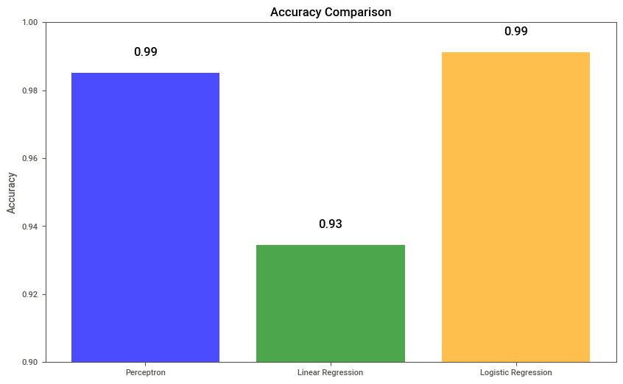
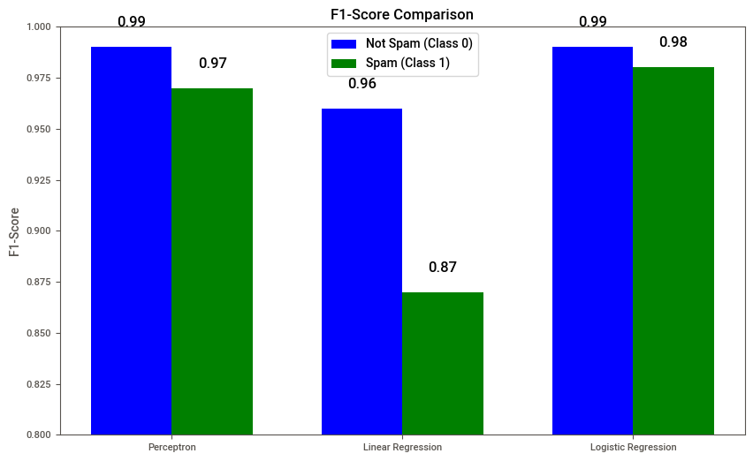
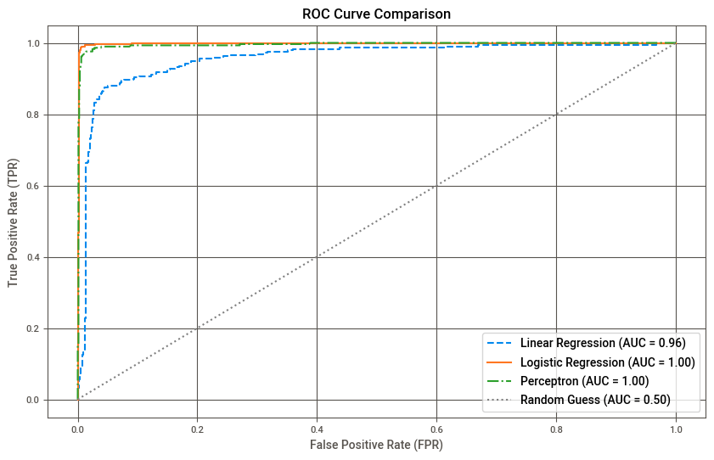
Accuracy & F-1 Score comparison
Accuracy Score: is the fraction of correct classifications. In this case, Logistic Regression is the best
F1-Score: This is the harmonic mean of precision and recall. The closer this value is to 1, the more balanced the model is regarding performance (Buhl,2023). The logistic regression classifier showed good performance in both classes.
ROC (AUC): The ROC-AUC further shows that the logistic classifier outperforms the two other models, with the linear regressor third

Slide 6
Conclusions
The logistic regression classifier performed the best for spam detection. It can be used as a starting point for a binary classification problem considering the no-free lunch theorem. The no free lunch theorem posits there is no best algorithm for every problem and less complex models can be the best solution to complex problems (Wikipedia, 2024).
Linear regression provides insights but is not ideal for classification. It could be used as a benchmark model. This means any binary classification model should, at a minimum, perform better than the linear regression model before it is deployed in production.
Finally, the Perceptron could be considered a lightweight option for binary spam detection that can be used in production. It is a straightforward implementation and performs well, as noted in the results.

Slide 7


References
Roy, A. (2018). Chapter 1 - Introduction to CRISP DM Framework for Data Science and Machine Learning | LinkedIn. https://www.linkedin.com/pulse/chapter-1-introduction-crisp-dm-framework-data-science-anshul-roy/
Jackksoncsie. (2023). Spam email Dataset. https://www.kaggle.com/datasets/jackksoncsie/spam-email-dataset/data
GeeksforGeeks. (2023). Logistic Regression using Python. https://www.geeksforgeeks.org/ml-logistic-regression-using-python/
DataCamp. (2024). Python Logistic Regression Tutorial with Sklearn & Scikit. https://www.datacamp.com/tutorial/understanding-logistic-regression-python

Slide 8
References
GeeksforGeeks. (2024). What is Perceptron | The Simplest Artificial neural network. https://www.geeksforgeeks.org/what-is-perceptron-the-simplest-artificial-neural-network/
scikit-learn: machine learning in Python — scikit-learn 1.5.2 documentation. (n.d.). Retrieved November 25, 2024, from https://scikit-learn.org/1.5/index.html
Buhl, N. (2023). F1 Score in Machine Learning Explained. Encord. https://encord.com/blog/f1-score-in-machine-learning/
Wikipedia. (2024). No free lunch in search and optimization - Wikipedia. Wikipedia. https://en.wikipedia.org/wiki/No_free_lunch_in_search_and_optimization

Slide 9
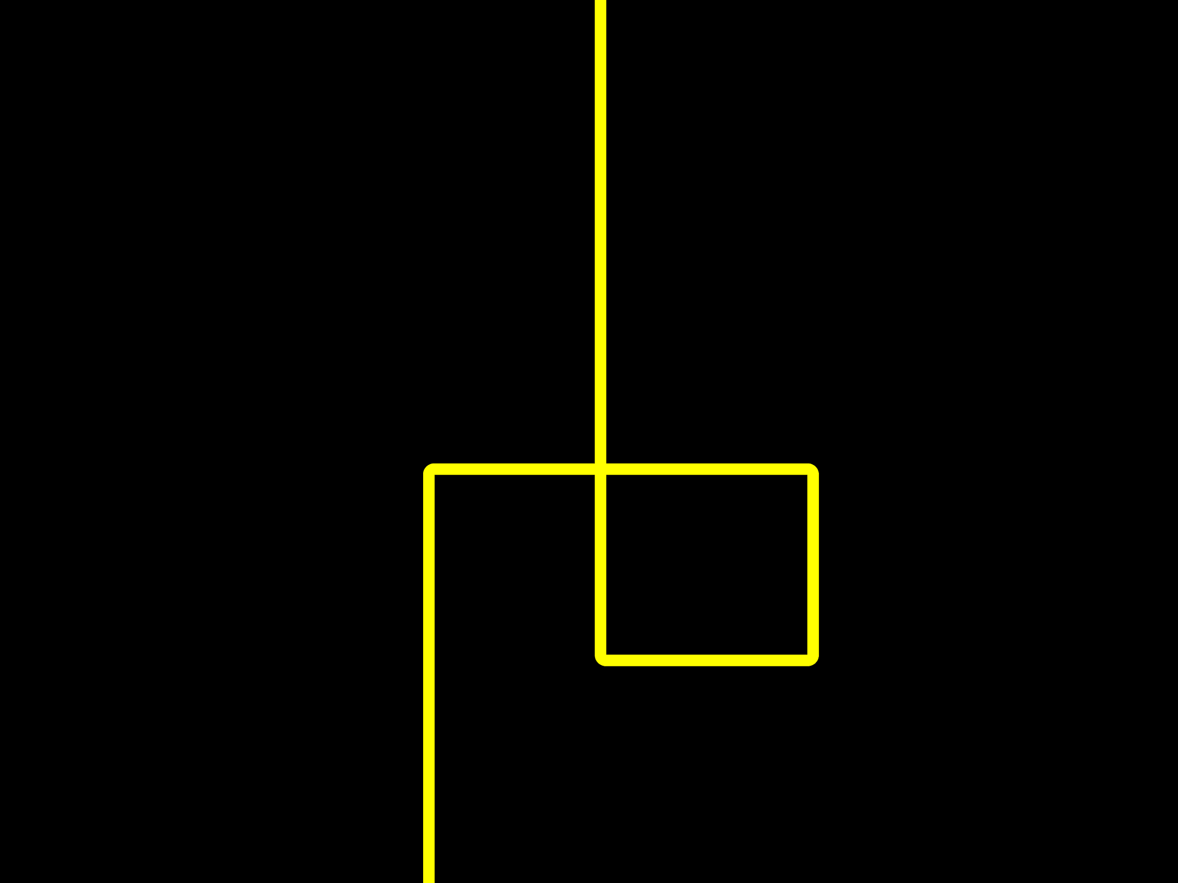
Thank you!

